Slide 1

AI-Powered Recipe Recommendation System
SOA Project Review-2
 | Under the Guidance of Dr.Neelima Gogineni Professor, Department of Computer Science and Engineering, KLH CSE Bowrampet Campus
Team Members Name: A.Lakshman Roll Number :2420030067 Name : Sanivarapu Sadhana Roll Number: 2420030225 Name: Maddipatla Pavani Sree Roll Number: 2420030336

Slide 2
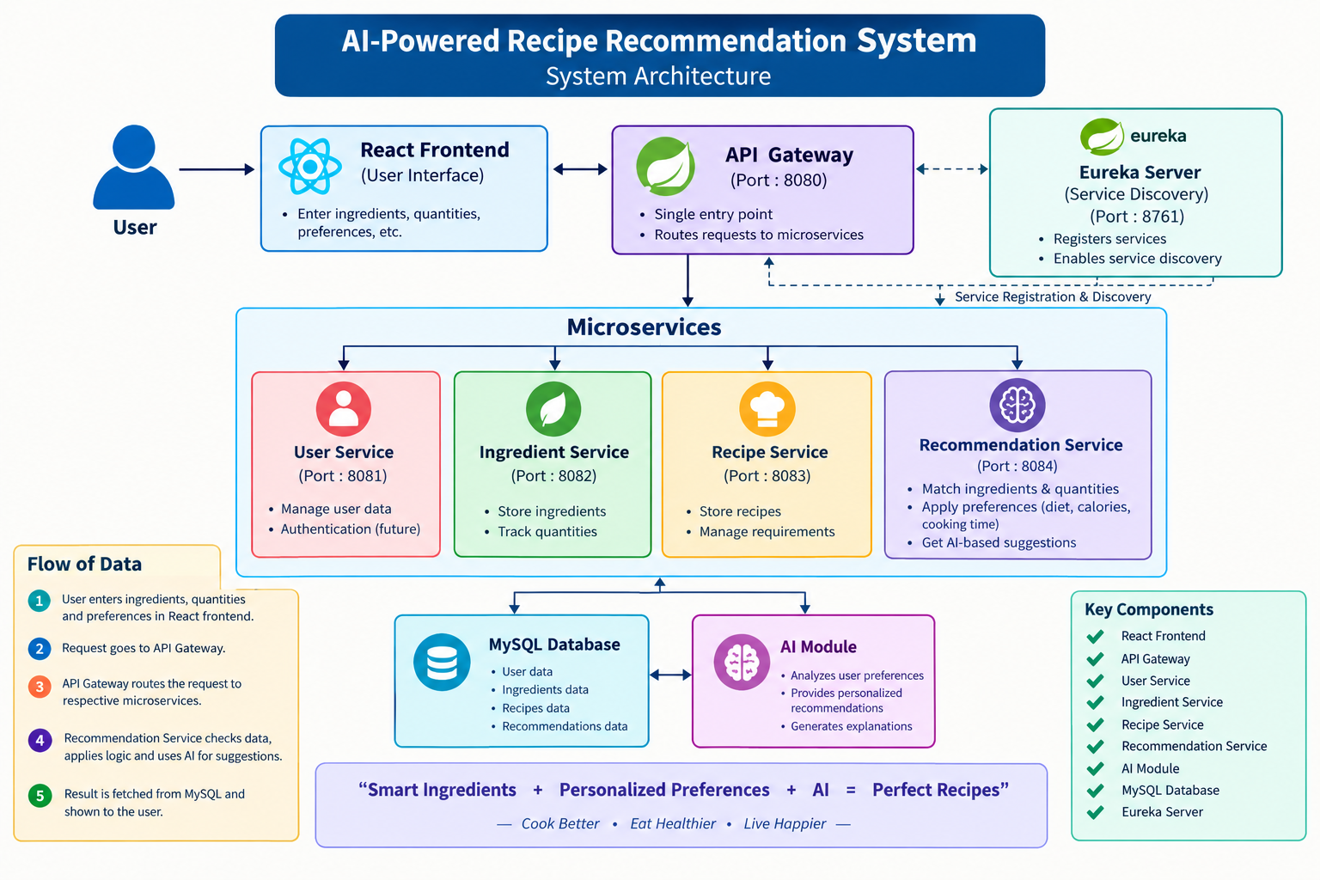
Architecture

Slide 3
Methodology
User Input: Enter available ingredients, quantities, dietary preferences, calorie requirements, and cooking time.
Ingredient Analysis: Analyze the available ingredients and their quantities.
Recipe Matching: Match available ingredients with recipe requirements.
Preference Filtering: Filter recipes based on dietary preferences, calories, and cooking time.
AI Recommendation: Use AI to provide personalized recipe suggestions.
Recipe Ranking: Rank recipes based on their suitability.
Final Output: Display the most suitable recipes to the user.

Slide 4
Technical Soundness
AI-Based Recommendation: Uses AI techniques to recommend recipes based on user requirements.
Personalized Input: Considers ingredients, cuisine, dietary preference, spice level, and cooking time.
Recipe Matching: Matches user inputs with available recipes to generate suitable recommendations.
Ingredient Substitution: Suggests alternative ingredients when required ingredients are unavailable.
Microservices Architecture: Divides the application into independent services such as User, Recipe, and Recommendation services.
REST APIs: Enables communication between different services and application components.
Service Discovery: Eureka helps microservices discover and communicate with each other.
API Gateway: Provides a single entry point for client requests and routes them to the appropriate service.
Security: JWT authentication can be used to provide secure access to user-related services.
Testing: Postman is used to test APIs and verify communication between services.
Scalability: Microservices allow individual services to be developed, updated, and scaled independently.
Maintainability: Separating the system into modules makes the application easier to maintain and extend.

Slide 5
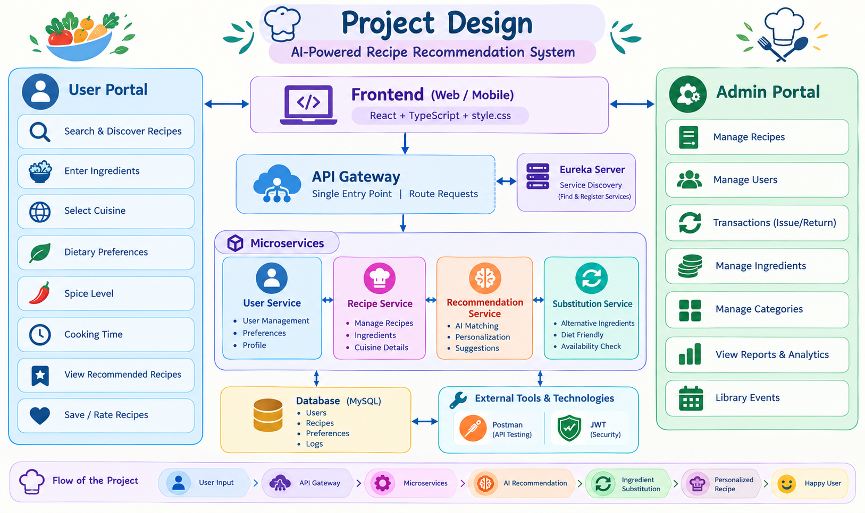
Project Design
USER
↓
REACT FRONTEND
↓
API GATEWAY
↓
USER | INGREDIENT | RECIPE SERVICES
↓
RECOMMENDATION SERVICE
↓
AI & RECOMMENSATION
MODULE
↓
MYSQL DATABASE
↓
RECOMMENDED RECIPES

Slide 6
Implementation Status
1. Microservices Module :
Recipe Service handles recipe-related operations.
Recommendation Service handles AI recommendations.
User Service manages user information and preferences.
2. User Input Module :
User enters available ingredients.
User can select cuisine type.
User can specify dietary preferences.
3. AI Recipe Recommendation Module:
Analyzes the user's inputs.
Matches available ingredients with recipes.
Considers cuisine, diet, spice level and cooking time.
Generates suitable recipe recommendations.
4. Preference & Personalization Module:
Maintains user preferences.
Uses previous choices to improve recommendations.
Provides more personalized recipe suggestions.
Helps the system understand individual food preferences.
5.API Gateway & Service Discovery:
API Gateway provides a single entry point for the application.
Eureka is used for service discovery.
Makes the system easier to manage and scale.

Slide 7
6. Security Module:
JWT authentication is used for secure user access.
Authenticates users before accessing protected services.
7. Ingredient Substitution Module:
Identifies unavailable ingredients.
Suggests possible substitute ingredients.
Helps users prepare recipes with available ingredients.
8. Recipe Database Module :
Stores recipe information.
Stores ingredients, cuisine, cooking time and dietary information.
Recipes are retrieved based on user requirements.
Provides the required recipe details to the recommendation module.
9. Testing & Integration Module:
Test REST APIs using Postman.
Test communication between microservices.
Verify recommendation results.

Slide 8
THANK YOU

